Slide 1
ENPM 667 : PROJECT 1
Prathinav Karnala Venkata (120380983)pratkv@umd.edu
Sarang Shibu (120254307)sarang@umd.edu

Slide 2
Paper summary
Paper - ‘Fuzzy Gain Scheduling of PID controller’
We perform a comparison of the 2 different tuning methods of PID controllers.
Zeigler-Nichols tuning method, generates fixed gain parameters for the PID controller.
Fuzzy Logic method, which generates the PID parameters dynamically according to a set of rules based on expert knowledge of how the response should ideally be.

Slide 3
Introduction to Fuzzy Logic
Understanding Fuzzy Logic
Definition: Fuzzy Logic is a form of multi-valued logic derived from fuzzy set theory to deal with reasoning that is approximate rather than precise.
Binary vs. Fuzzy: Unlike binary logic that only permits true or false values (0 or 1), fuzzy logic encompasses a range of values between 0 and 1, representing the degree of truth.
Origins: Conceptualized by Lotfi A. Zadeh in 1965, fuzzy logic extends classical set theory to handle partial membership.
Real-World Application: Used in systems that require an inexact solution such as control systems, pattern recognition, and decision making

Slide 4
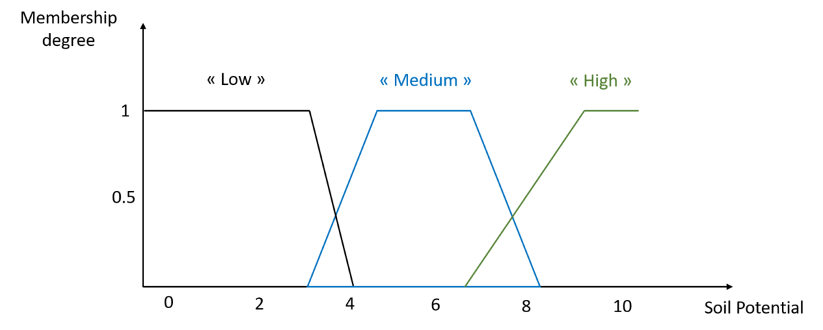
Reference: https://www.aspexit.com/fuzzy-logic-or-the-extension-of-classical-logic/
An example of 3 classes of soil potential, and therefore 3 membership functions to the soil potential variable

Slide 5
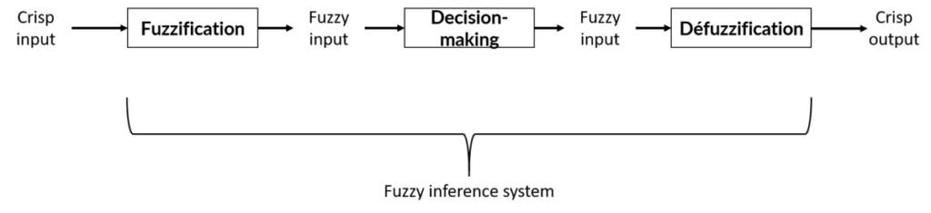
Fuzzy inference systems
A fuzzy inference system is a system composed of three large bricks: fuzzification, decision making and defuzzification. It's a framework for processing data through fuzzy logic to arrive at a definite conclusion.
Crisp Input Defined:
Exact values with no ambiguity.
Example: Temperature is exactly 70°F.
Introduction to Fuzzification:
Transforms crisp data into fuzzy sets.
Assigns a membership degree to each input

Slide 6
Membership Functions:
Define how inputs relate to fuzzy set terms: "low," "medium," "high."
Can be triangular, trapezoidal, bell-shaped, etc.
Determine input's degree of membership.
Fuzzy Values:
The outcome of mapping crisp inputs to fuzzy sets.
Represent inputs with degrees of truth.
Fuzzy Inference System Decision-Making:
Applies logic rules to fuzzy inputs.
Outputs fuzzy results for further processing.
Inference Engine Operations:
Assesses applicable rules using membership values.
Aggregates rule outputs into a single fuzzy set.
Defuzzification Overview:
Converts fuzzy output to a crisp, actionable result.
Centroid method to be discussed: balances all outcomes for a precise decision.

Slide 7
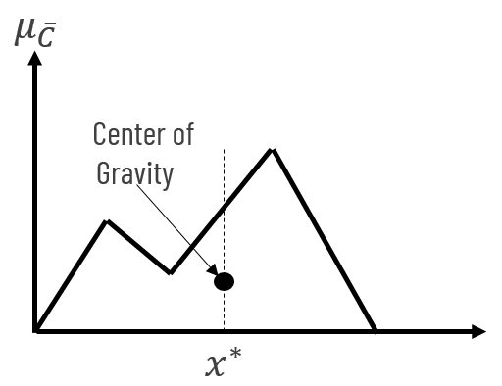
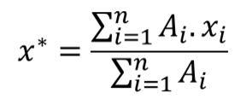
Centroid method(or Centre of Gravity) of Defuzzification
Overview
Most prevalent and intuitively appealing method for defuzzification
Balances a fuzzy set to find a crisp, precise output value
Principle
Identifies the point x∗that divides the membership function's area into two equal masses
Process
Calculates the center of gravity for the fuzzy set
Utilizes the aggregate area under the membership function

Slide 8
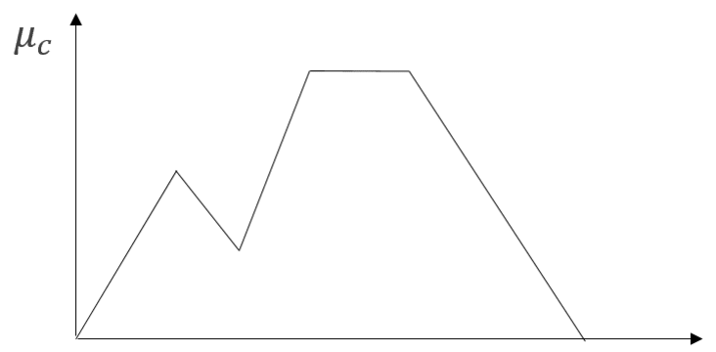
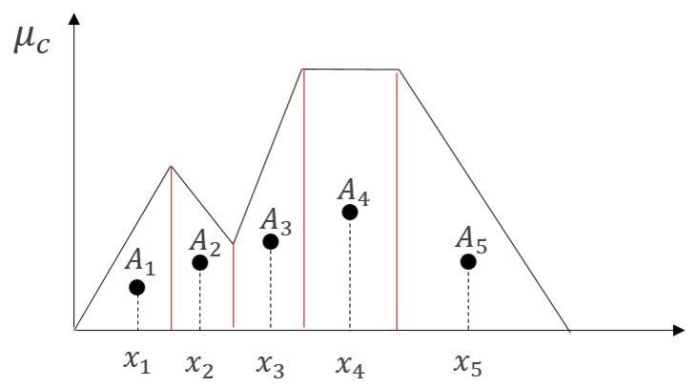
Centroid method(cont.)
Sub-Area Calculation
Divides the overall area into shapes (e.g., triangles, trapezoids)
Determines the area and centroid for each shape
Defuzzified Output
Summation of all sub-area centroids weighted by their respective areas
Yields a single, discrete value representing the combined control action
Aggregated fuzzy output (before division)
Aggregated fuzzy output (after division)

Slide 9
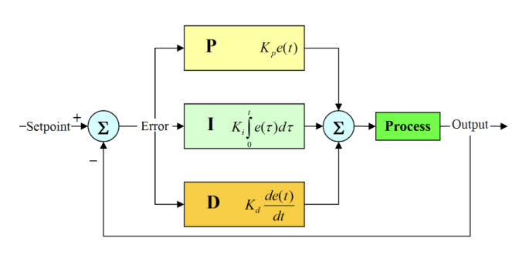
PID controller
The PID controller is a combination of the proportional controller, the integral controller, and the derivative controller.

Slide 10
PID controller
Each component of a PID controller complements the others, addressing their limitations to minimize errors and optimize system performance effectively.
Proportional (P)
Action: Generates output directly proportional to the error, which is the discrepancy between the setpoint and the process variable.
Purpose: Offers quick error correction with response intensity matching the error size.
Effect: High gains may cause instability; low gains might result in weak responses.

Slide 11
Integral (I) Block:
Action: Integrates the error over time, outputting in proportion to total error.
Purpose: Eliminates steady-state error left by the P component.
Effect: Achieves setpoint accuracy, but excessive use can cause instability.
Derivative (D) Block:
Action: Outputs according to the error's rate of change.
Purpose: Foresees error trends and applies damping to minimize overshoot.
Effect: Stabilizes the system but can be disrupted by noise in error measurement.

Slide 12
Fuzzy Logic Controller
The fuzzy logic controller is a tool that is available in MATLAB, that allows us to implement fuzzy logic.
To implement fuzzy tuning for the PID controller. We assign fuzzy sets to the error and first difference of the error.
The error and error difference fuzzy sets are as follows:
NB, NM, NS, ZO, PS, PM, PB.
Here N - Negative, P - Positive and S - Small, M - Medium, and B - Big, ZO - approximately zero.
Therefore, NB is Negative big, PS - positive small. Etc.

Slide 13
Fuzzy Logic Controller
Here the fuzzy sets, describe the kind of error that is present, that is, if its is negative or positive. If the magnitude is small, medium, or big. It helps classify the error e(k) and the change in error Δe(k) into these categories.
The error e(k)’s membership functions of the fuzzy set are described as follows:
The membership function μ of e(k) has the range [0,1].
We used triangular functions to describe the the membership function of each of the fuzzy sets as shown in the next slide.
The values of e(k) range from [-3,3].

Slide 14
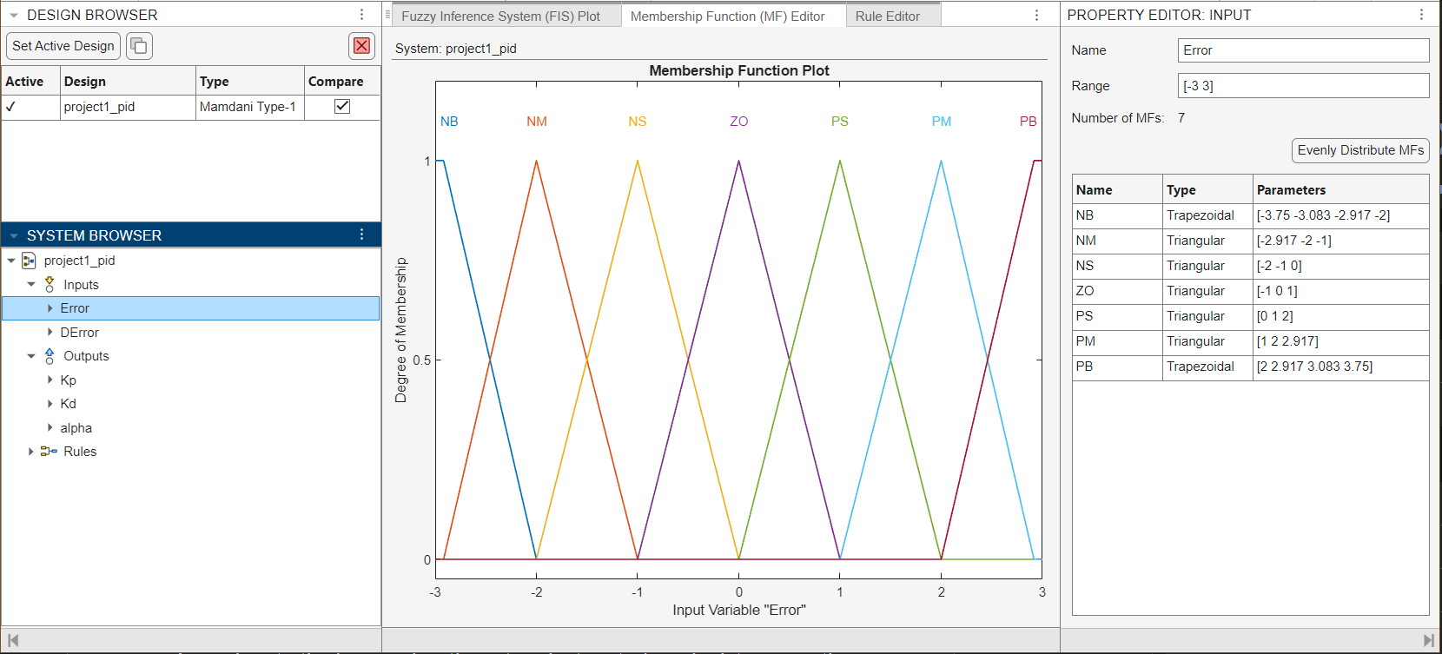
This the membership function graph of error e(k)

Slide 15
Fuzzy Logic Controller
The error difference Δe(k)’s membership functions of the fuzzy set are described as follows:
The membership function μ has the range [0,1].
We used triangular functions to describe the the membership function of each of the fuzzy sets as shown in the next slide.
The values of the Δe(k) range from [-3,3]

Slide 16
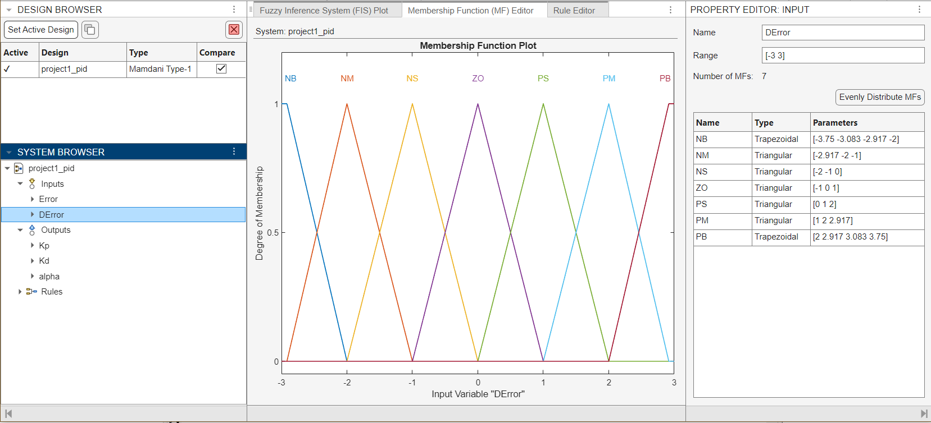
This the membership function graph of error Δe(k)

Slide 17
Fuzzy Logic Controller
The outputs of the fuzzy controller are also fuzzy sets:
They yield the normalized value of the Proportional Gain Kp’, normalized Derivative Gain Ki’, and the α.
Since the values of Kp’ and Kd’ are normalized their values will be in the range [0,1].
The fuzzy sets or categories the values of Kp’ or Kd’ can fall into are
Small (S) or Big (B).

Slide 18
Fuzzy Logic Controller
The value of the membership function for Kp’ and Kd’ have the custom functions:
µsmall(x) = (−1/4) ln(x) or xsmall(µ) = e^( −4µ)
µbig(x) = (− 1/4) ln(1 − x) or xbig(µ) = 1 − e (−4µ)
The membership graph of normalized Kp’ and Kd’ are shown in the next slide:
The value of µ ranges from [0,1].
The values of Kp’ or Kd’ range from [0,1].

Slide 19
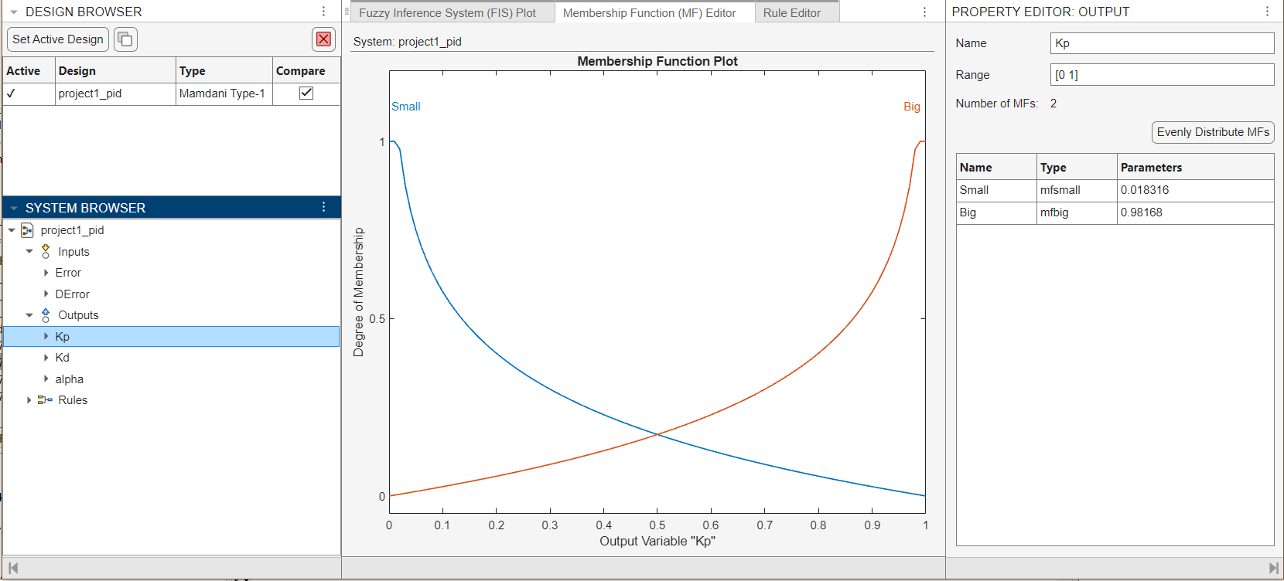
Small (S)

Slide 20
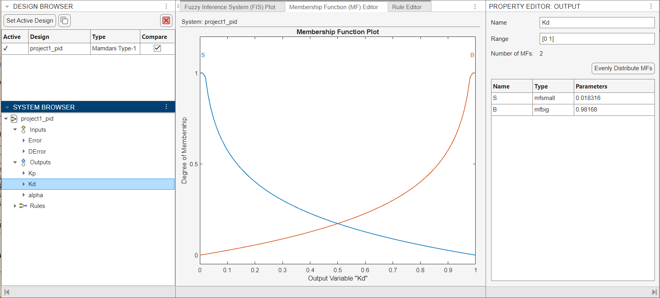
Big (B)

Slide 21
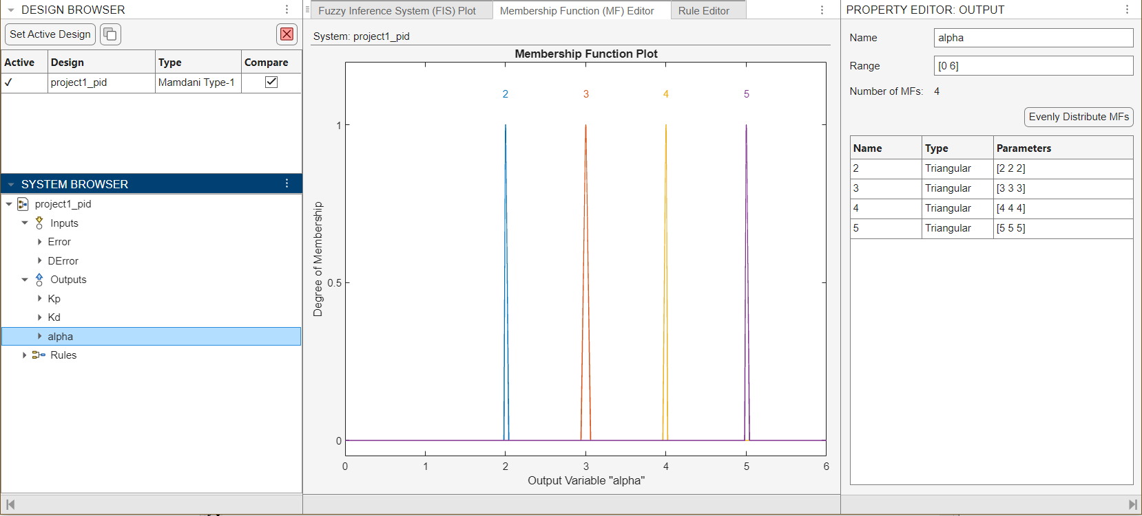
Fuzzy Logic Controller
The fuzzy output α has singleton membership function, and its values range from
α = {2,3,4,5}

Slide 22
Fuzzy Logic Controller
The fuzzy logic controller outputs (Kp’,Kd’, and α) depend on the fuzzy rule base. These rules are based on the expert knowledge of how the system’s response should behave. Based on this knowledge the outputs are generated.
The rules depend on the inputs and the outputs of the fuzzy logic controller.
There are a total of 49 rules applied to this Fuzzy Logic Controller.
The inputs are the error e(k) and Δe(k).
The outputs are Kp’, Kd’, and α.
The rules are written in this form:
If e(k) is Ai, and Δe(k) is Bi, then Kp’ is Ci, Kd’ is Di, and α = αi.

Slide 23
Fuzzy Logic Controller
Here the Ai is the fuzzy set = {NB,NM,NS,ZO,PS,PM,PB}
Here Bi is the fuzzy set = {NB,NM,NS,ZO,PS,PM,PB}
Ci is the fuzzy set = {Small, Big}
Di is the fuzzy set = {Small, Big}
α is the fuzzy set = {2,3,4,5}
The fuzzy set describes the type of value they are.

Slide 24
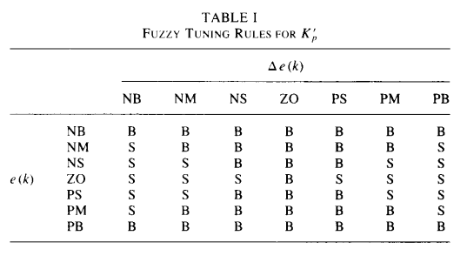
Fuzzy Logic Controller
Based on the expert knowledge base, these were the rules that we set for the fuzzy logic controller for Kp’:

Slide 25
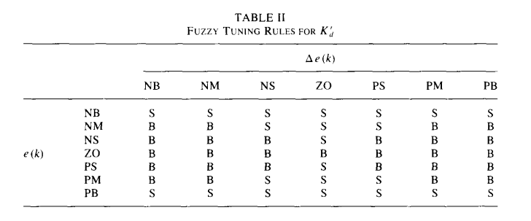
Fuzzy Logic Controller
Based on the expert knowledge base, these were the rules that we set for the fuzzy logic controller for Kd’:

Slide 26
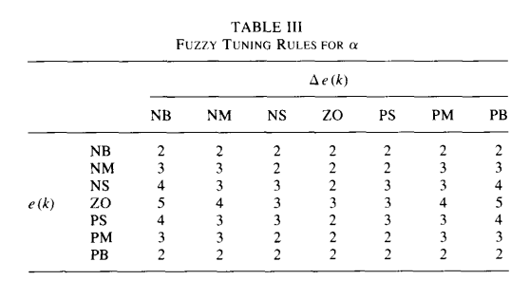
Fuzzy Logic Controller
Based on the expert knowledge base, these were the rules that we set for the fuzzy logic controller for α:

Slide 27
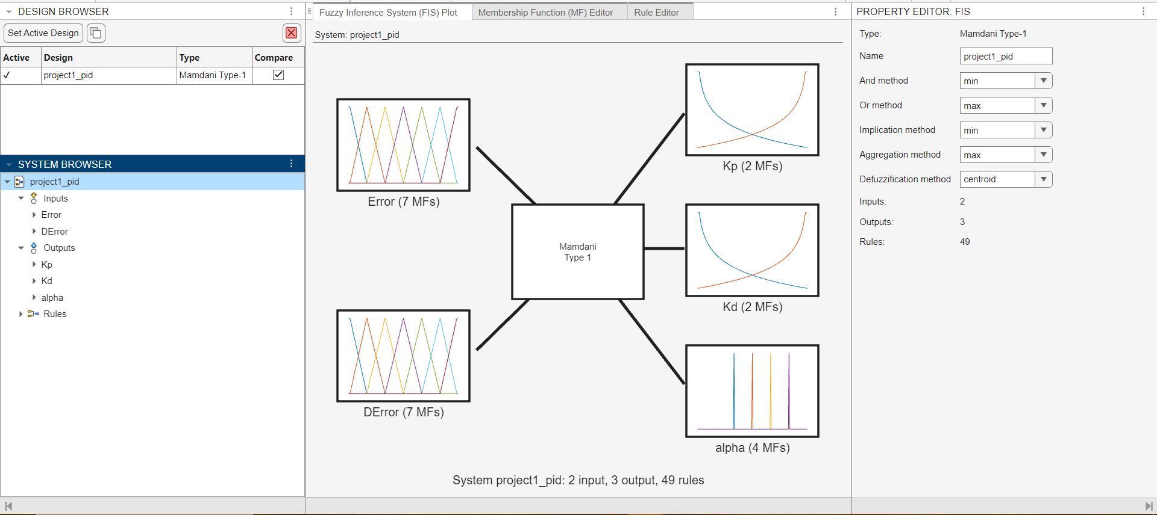
Final form of the fuzzy logic controller- 2 inputs e(k) and Δe(k) and the 3 outputs Kp’, Kd’, and α.

Slide 28
Fuzzy Logic Controller
This fuzzy logic controller will dynamically produce the values for Kp’, Kd’, and α.
We use a function to convert the normalized values to the actual values.
Using the formula:
Kp = Kp’ (Kpmax − Kpmin ) + Kpmin
Kd = Kd’ (Kdmax − Kdmin ) + Kdmin
Ki = Kp^2 / (α.Kd)
Where the values of Kpmax = 0.6Ku , Kpmin = 0.32Ku
Kdmin = 0.08KuTu and Kdmax = 0.15KuTu

Slide 29
Zeigler - Nichols Tuning Method
The value of Ku and Tu are determined by Zeigler-Nichols tuning method.
It is done as follows:
1. Initially, set the parameters Kp = 0, Kd = 0, and Ki = 0 for the PID controller and check the step response of the system.
2. Gradually increase the value of KP until sustained oscillation is observed in the step response of the system.
3. The gain at which these sustained oscillations occur is the Ultimate gain (Ku).
4. The time period of oscillation (Tu) can also be obtained from the graph.

Slide 30
Second Order System
The system is defined using:
Applying Zeigler-Nichol's method,
We have found that the
ultimate gain Ku = 4.68
Time period of the sustained oscillation Tu = 3.28 s
Proportional Gain Kp = 2.808,
Derivative gain Kd = 1.15128,
Integral gain Ki = 1.7122,
Integral Time constant = 3.28 s,
Derivative Time constant = 0.41 s.

Slide 31
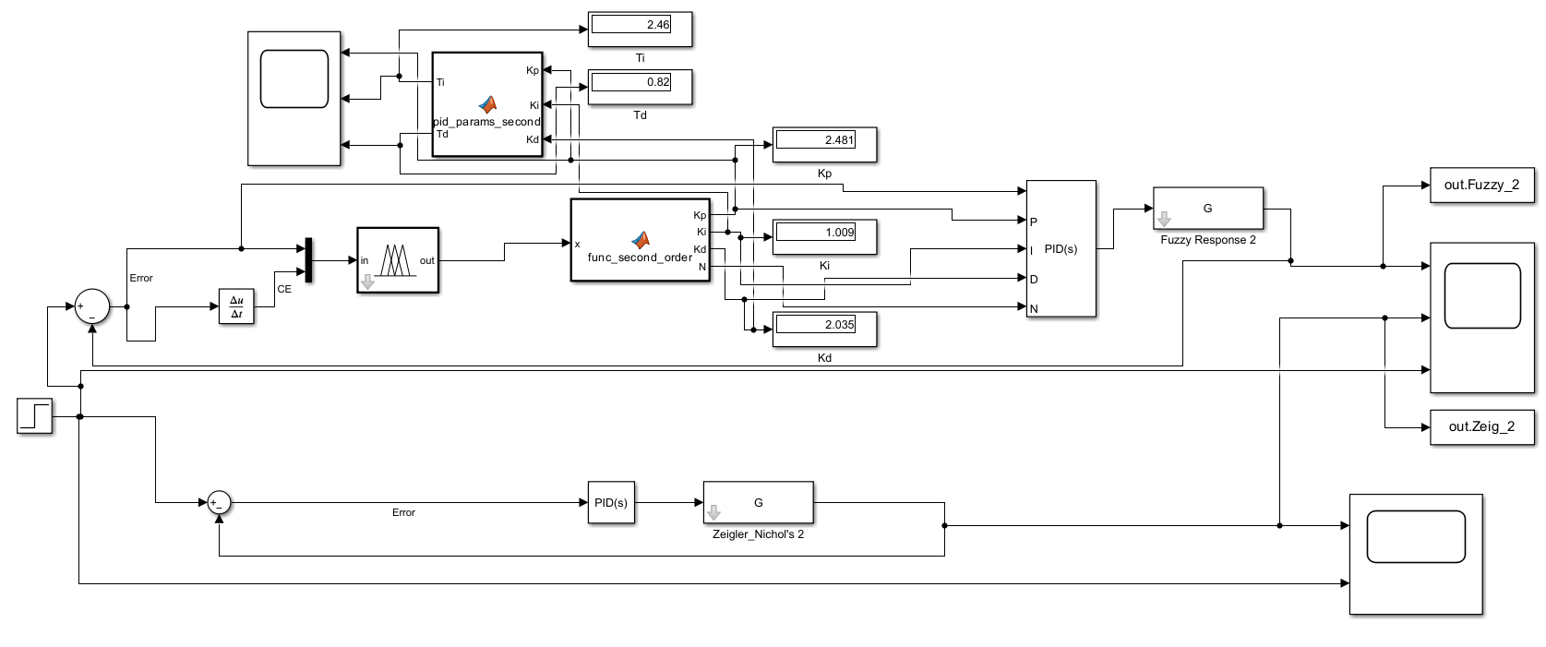
Second Order system

Slide 32
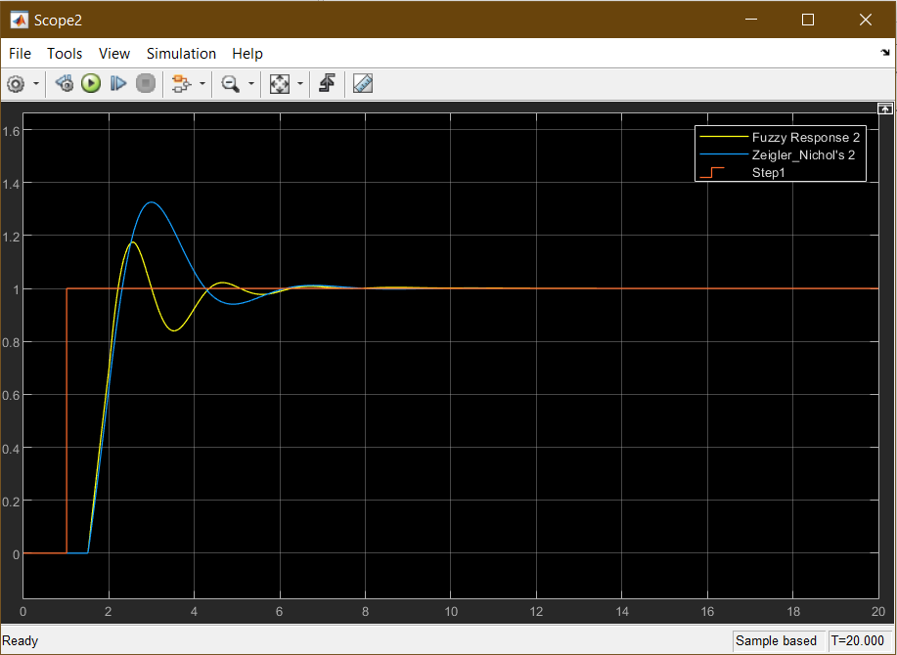
Second order system response

Slide 33
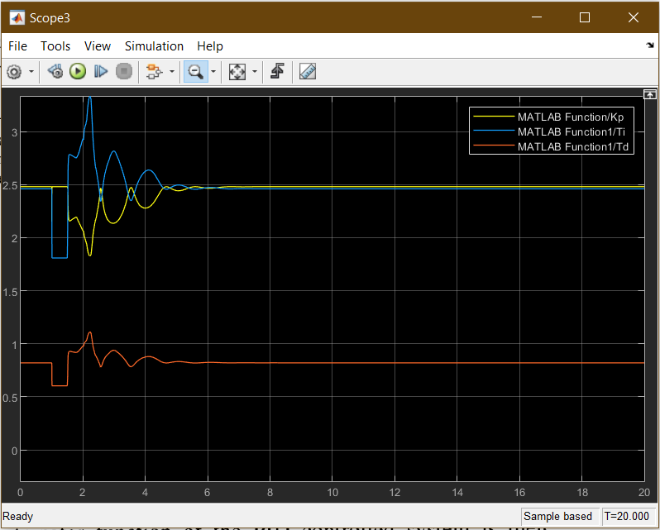
Second order system Parameter range of Kp, Ti, and Td

Slide 34
Third Order System
Applying the Zeigler-Nichols method,
We have found that the ultimate gain Ku = 3.65,
Time period of the sustained oscillation Tu = 2.06s
Proportional Gain KP = 2.19,
Derivative gain KD = 0.56502,
Integral gain KI = 2.1262,
Integral Time constant TI = 1.03s,
Derivative Time constant TD = 0.258s.

Slide 35
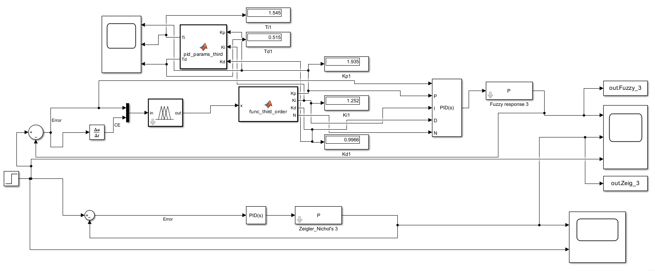
Third order system

Slide 36
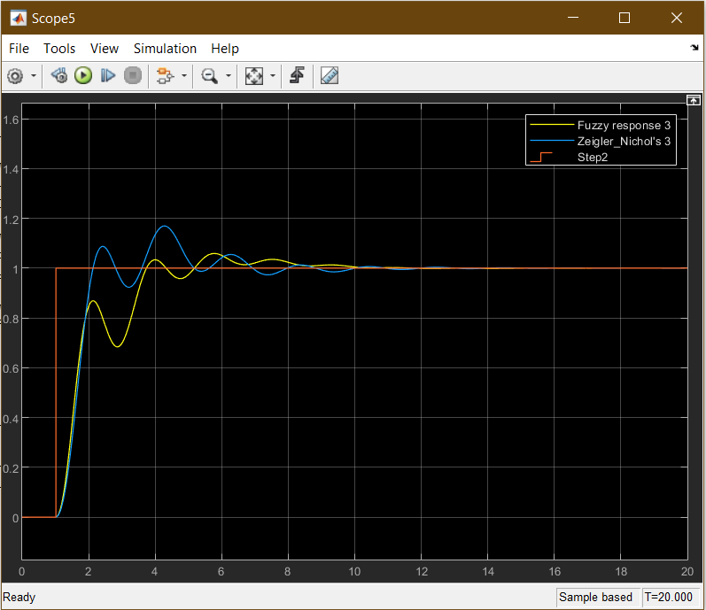
Third Order System Response

Slide 37
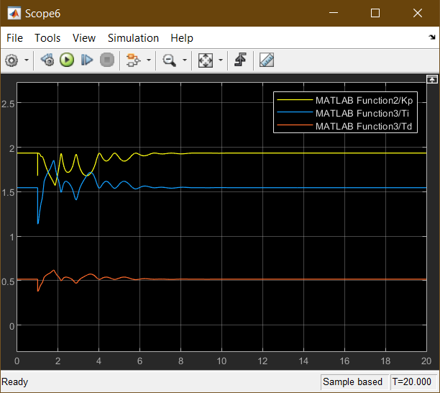
Third Order System Parameter range of Kp, Ti, and Td

Slide 38
Fourth Order system
Applying the Zeigler-Nichols method,
We have found that the ultimate gain Ku = 5.12,
Time period of the sustained oscillation Tu = 2.704s
Proportional Gain KP = 3.072,
Derivative gain KD = 1.0383,
Integral gain KI = 2.272189,
Integral Time constant TI = 1.352s,
Derivative Time constant TD = 0.338s.

Slide 39
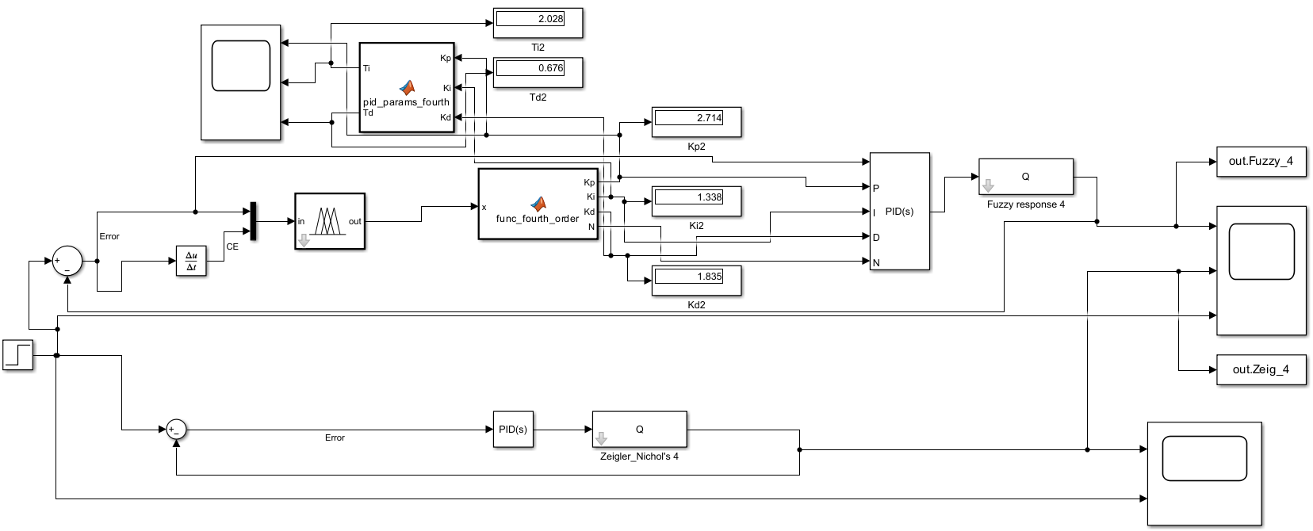
Fourth Order System

Slide 40
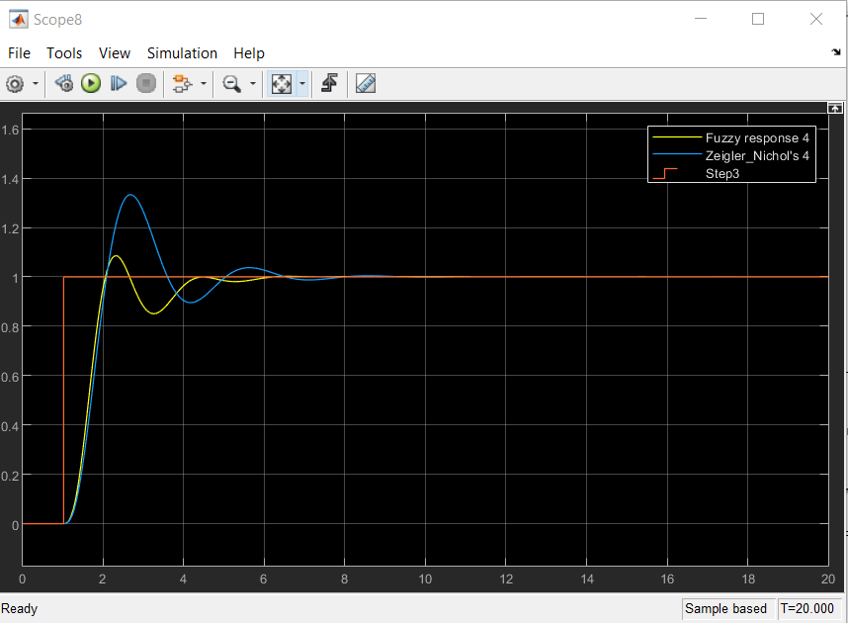
Fourth Order System Response

Slide 41
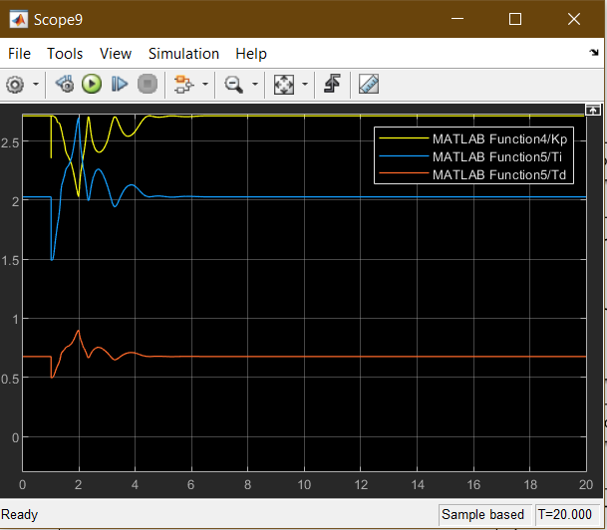
Fourth Order System Parameter range of Kp, Ti, and Td

Slide 42
The results of second order system: Fuzzy Tuning
RiseTime: 0.5541,
TransientTime: 5.7650,
SettlingTime: 5.7650
SettlingMin: 0.8397
SettlingMax: 1.1749
Overshoot: 17.4911
Undershoot: 0
Peak: 1.1749
PeakTime: 2.5607

Slide 43
The results of second order system: Zeigler-Nichols Tuning
RiseTime: 0.6226
TransientTime: 5.7314
SettlingTime: 5.7314
SettlingMin: 0.9101
SettlingMax: 1.3257
Overshoot: 32.5699
Undershoot: 0
Peak: 1.3257
PeakTime: 3.0042

Slide 44
The results of third order system: Fuzzy Tuning
RiseTime: 2.2246
TransientTime: 8.0915
SettlingTime: 8.0915
SettlingMin: 0.9074
SettlingMax: 1.0590
Overshoot: 5.8957
Undershoot: 0
Peak: 1.0590
PeakTime: 5.7669

Slide 45
The results of third order system: Zeigler-Nichols Tuning
RiseTime: 0.7175
TransientTime: 7.6319
SettlingTime: 7.6319
SettlingMin: 0.9157
SettlingMax: 1.1696
Overshoot: 16.9708
Undershoot: 0
Peak: 1.1696
PeakTime: 4.2840

Slide 46
The results of fourth order system: Fuzzy Tuning
RiseTime: 0.6242
TransientTime: 4.1124
SettlingTime: 4.1124
SettlingMin: 0.8508
SettlingMax: 1.0854
Overshoot: 8.5360
Undershoot: 7.4074e-31
Peak: 1.0854
PeakTime: 2.3215

Slide 47
The results of fourth order system: Zeigler-Nichols Tuning
RiseTime: 0.6554
TransientTime: 6.1335
SettlingTime: 6.1335
SettlingMin: 0.8955
SettlingMax: 1.3329
Overshoot: 33.2852
Undershoot: 1.6412e-32
Peak: 1.3329
PeakTime: 2.6809

Slide 48
Conclusion
It is quite evident that the fuzzy gain scheduling results in a satisfactory transient response as compared to the Zeigler-Nichols tuning method. The data from the step response of the second and fourth order system shows that the Fuzzy tuner is better compared to the Zeigler-Nichols method.
For the third order, the Rise time, transient time, settling time, and peak time are a tad higher for the fuzzy tuning method as compared to the Zeigler-Nichols tuning method.

Slide 49
Video of Simulation
https://drive.google.com/file/d/1TAnO4tuq2YZUzF-BhV0cf1uP8aNlAJP4/view?usp=sharing

